Slide 1
An Intuitive Framework for Real-Time Freeform Modeling
Mario Botsch Leif Kobbelt
Computer Graphics Group
RWTH Aachen University
Presented By: Yissachar Abraham
Manor Zvi
Notes:
Roughly 300 citations
Botsch h index: 48
Kobbelt h index: 75

Slide 2
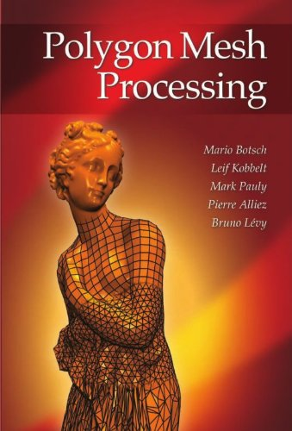
The Authors
Mario Botsch
Prof. at TU Dortmund University (Computer Graphics & Geometry Processing)
Leif Kobbelt
Prof. at RWTH Aachen University (Computer Graphics)
Wrote together our course book – Polygon Mesh Processing

Slide 3
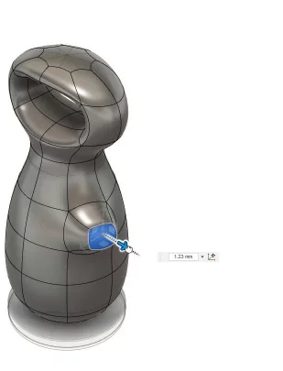
The Goal
Freeform modeling framework
Simple user interaction even for complex freeform modifications
Easy to use even for non-expert user
Do it fast (real time)! (relative to 2004)
Example (minutes 3:35-5:30): https://www.youtube.com/watch?v=dO8HFSGaOmU
Notes:
Freeform modeling is the process of conveying an imaginary shape to a computer-aided design in an intuitive fashion.
It is still a major bottleneck, especially in the early stages of the design process
The example is not triangle mesh, but to emphasize the idea of freeform modeling.

Slide 4

Background
The fundamental problem is that the space of possible geometric shapes is extremely high dimensional
The designer explores the space only by clicking and dragging 2D positions on screen
This is the reason why it takes highly skilled experts to operate CAD system.

Slide 5
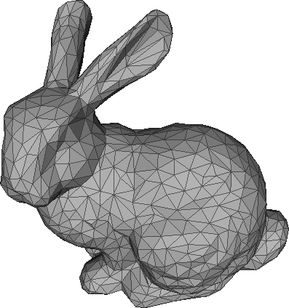

Background – Cont.
3-dof (translation) control vertices
6-dof (translation + rotation) manipulator object
9-dof (translation + rotation + scaling) manipulator object
This is us
Notes:
6-dof / 9-dof is not defined for a pointy object

Slide 6

Related Work
Sederberg & Parry (1986): Free-form deformation of solid geometric models
Coquillart (90): Extended free-form deformation: a sculpturing tool for 3D geometric modeling
MacCracken & Joy (95): Free-form deformations with lattices of arbitrary topology
The main idea is to embed the mesh inside a regular lattice of control points
Deformation of the lattice implies a deformation of the underlying mesh
Significant Drawback: the support of the modification is difficult to predict
Notes:
MacCracken uses Catmull-Clark subdivision methodology that successively refines a 3-dimensional lattice into a sequence of lattices
The support is the area of S that should be affected by the modification.

Slide 7
The Method (10K Feet View)
Select an arbitrary support – region of the surface that should be affected
Convex or non-convex
Smooth or non-smooth boundary
Can be easily defined by letting the user drawing on the surface by some Painting Tool
Decide a Characteristic Shape
Smoothness – how the deformed part of the surface connects with the unmodified part
Stiffness – how the curvature is distributed (equally distributed vs. clustered near the constraints)
Can be intuitively be controlled by a Slider: even non-expert user can ‘feel it’ by visual feedback
Select a handle contained inside the support
Define the Manipulator
Notes:
They also mention the ‘Fullness’, defined as: ‘relation between height and volume of the basis function (pointed vs. blobby)’
But it controlled implicitly by the selection of the handle

Slide 8
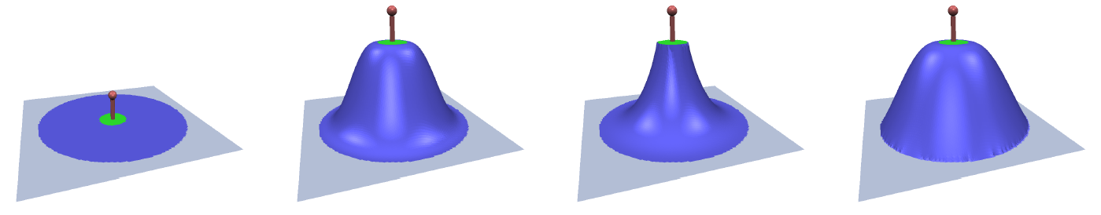
The Method (10K Feet View) – Cont.
Support, Handle & Manipulator
High smoothness in the inner & outer boundaries
High smoothness in the outer boundary and low in the inner boundary
High smoothness in the inner boundary and low in the outer boundary

Slide 9
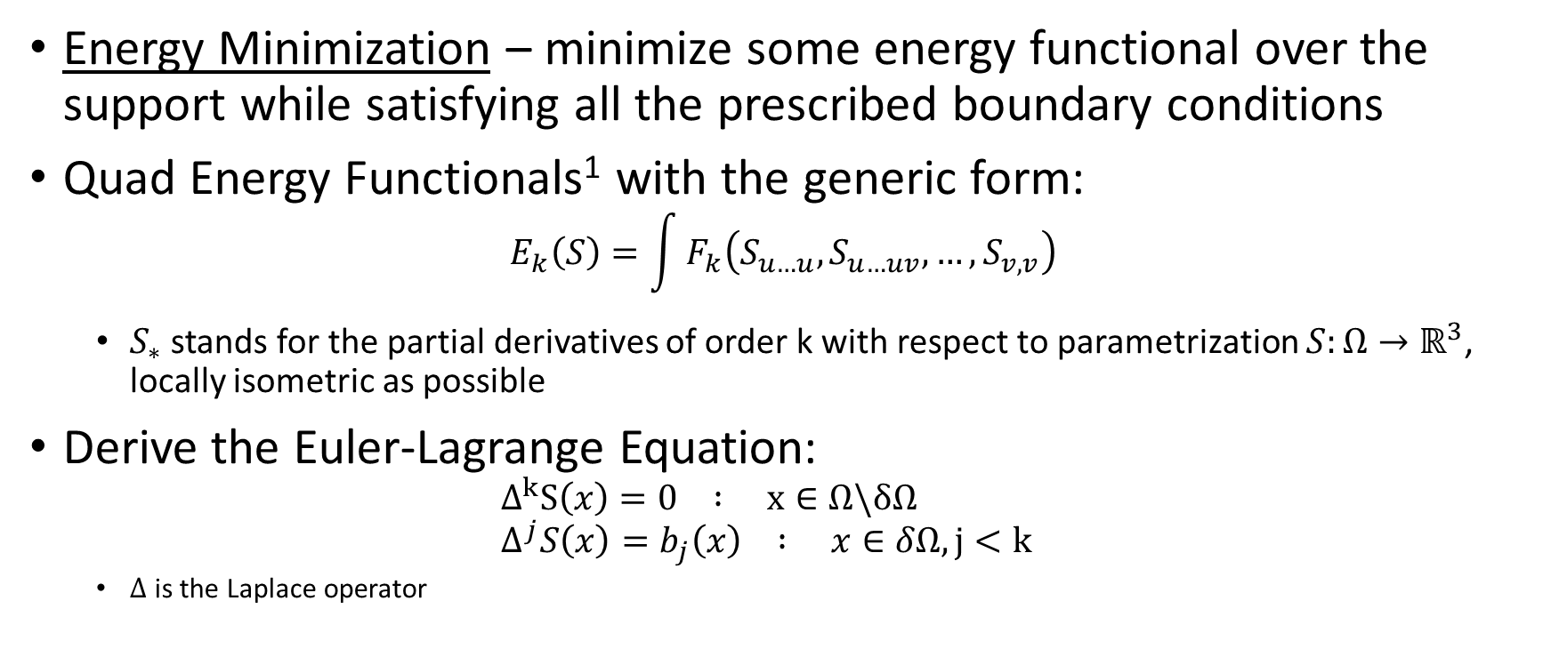
The Method – Deep Dive
Energy Minimization – minimize some energy functional over the support while satisfying all the prescribed boundary conditions
Quad Energy Functionals¹ with the generic form: $E_{k}\left(S\right)=\int{F_{k}\left(S_{u…u},S_{u…uv},…,S_{v,v}\right)}$
$S_{∗}$ stands for the partial derivatives of order k with respect to parametrization $S:Ω→ℝ^{3}$, locally isometric as possible
Derive the Euler-Lagrange Equation: $Δ^{k}S\left(x\right)=0 : x∈Ω\backslash δΩ$ $Δ^{j}S\left(x\right)=b_{j}\left(x\right) : x∈δΩ, j<k$
$Δ$ is the Laplace operator
Notes:
Interactive multi-resolution modeling on arbitrary meshes, Kobbelt, SIGGRAPH 97
Isometric parametrization: length preserving – the length of any arc on S is preserved on S’

Slide 10
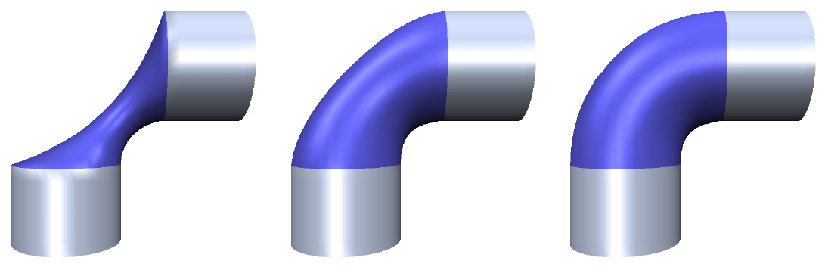
The Method – Deep Dive – Cont.
The order of k defines the stiffness and maximum smoothness:
K=1 – membrane surface (minimum area)
K=2 – minimum bending
K=3 – minimum curvature variation
Notes:
Not included here: recursive definition of higher order Laplacian:
$$Δ^{k}\left(p\right)=Δ\left(λ_{k−1}\left(p\right)∙Δ^{k−1}\left(p\right)\right) \\ λ_{k}\left(p\right)=\left\{\begin{matrix}1 :c\left(p\right)>k \\ c\left(p\right)−k : k−1≤c≤k \\ 0 :c\left(p\right)<k−1\end{matrix}\right.$$ where:
$$p−boundary vertex, \\ c\left(p\right) smoothness parameter$$

Slide 11
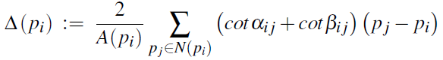
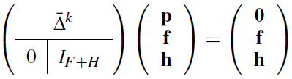
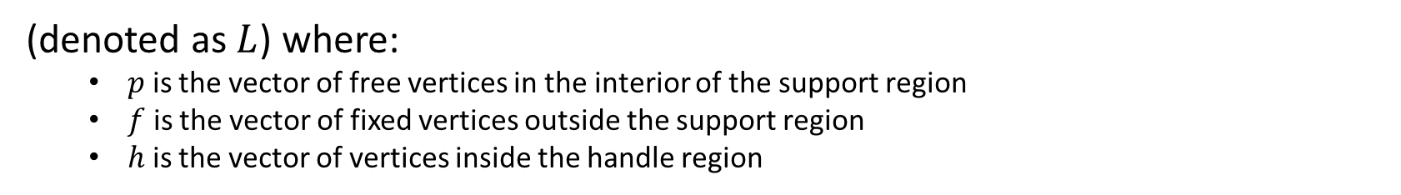
The Method – Deep Dive – Cont.
Discrete Laplace Operator:
By this, the Euler-Lagrange Equation becomes a sparse linear system:
(denoted as $L$) where:
$p$ is the vector of free vertices in the interior of the support region
$f$ is the vector of fixed vertices outside the support region
$h$ is the vector of vertices inside the handle region
When the user moves the handle, the vertices in $h$ change position and provides a new right hand-side for the linear system.

Slide 12



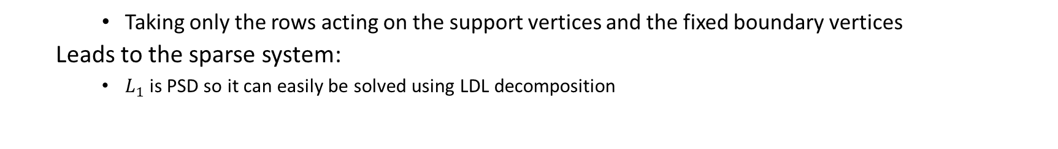
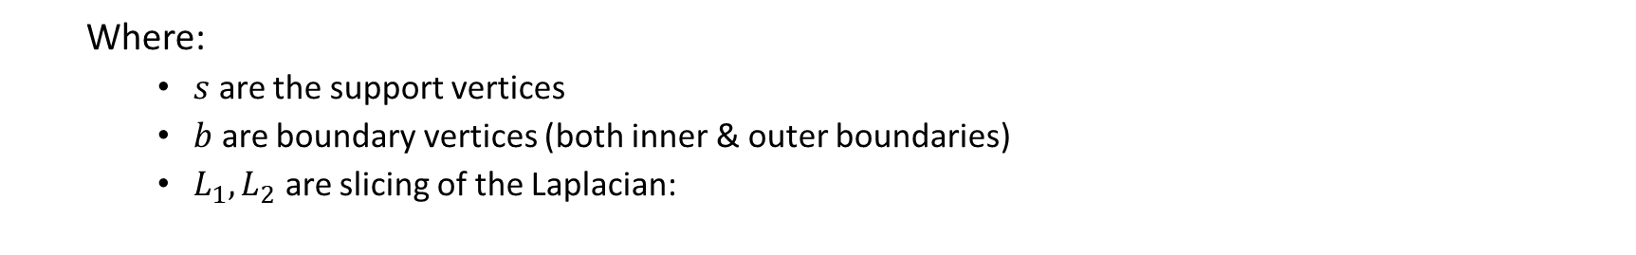
(Optional) The Method – Deep Dive – Cont.
Some Optimizations¹
We don’t really need to solve for ALL the mesh… only for the support and the k-ring boundary:
Where:
$s$ are the support vertices
$b$ are boundary vertices (both inner & outer boundaries)
$L_{1},L_{2}$ are slicing of the Laplacian:
Taking only the rows acting on the support vertices and the fixed boundary vertices
Leads to the sparse system:
$L_{1}$ is PSD so it can easily be solved using LDL decomposition
Notes:
1) https://github.com/Thanduriel/mesh-deformation

Slide 13
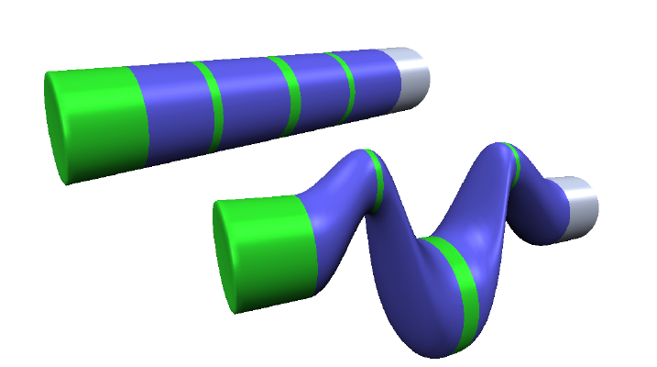
Results

Slide 14
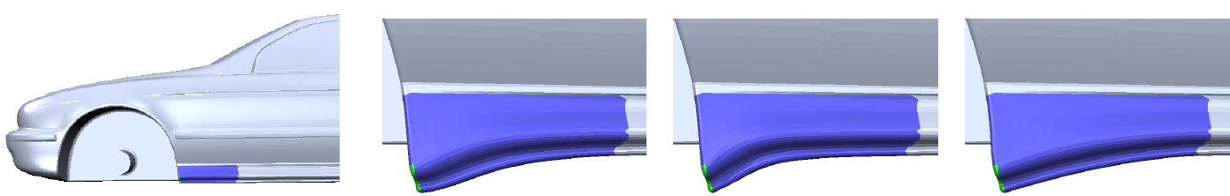
Results
Notes:
Sillboard modification using different smoothness

Slide 15
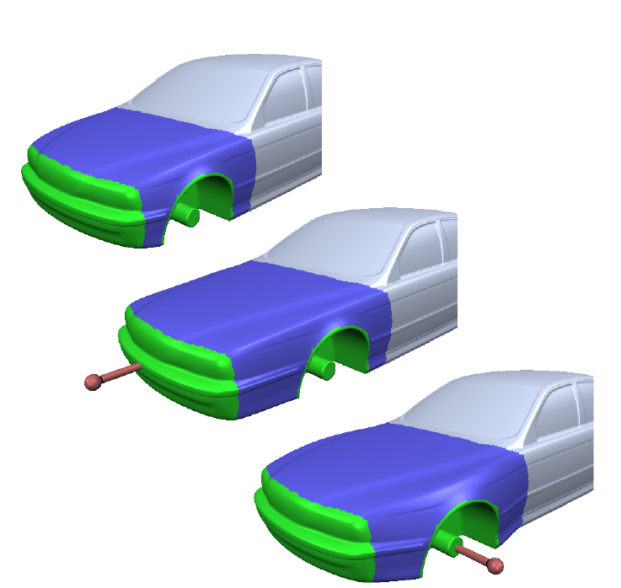
Results
Notes:
Multiple handles to preserve some features of the area of interest while allowing modifications of others

Slide 16
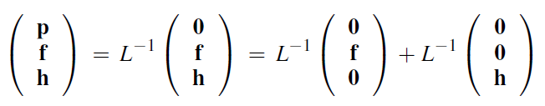

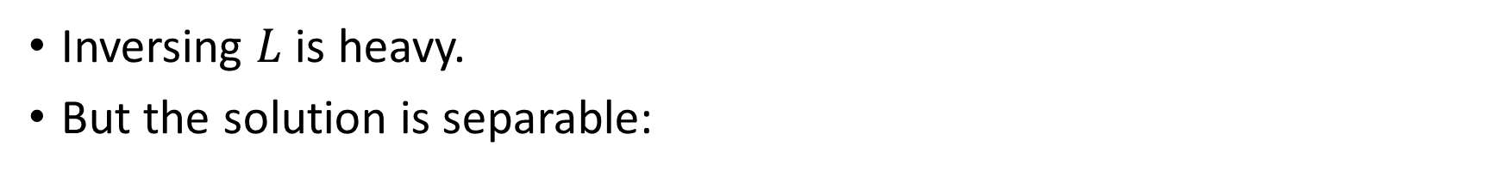
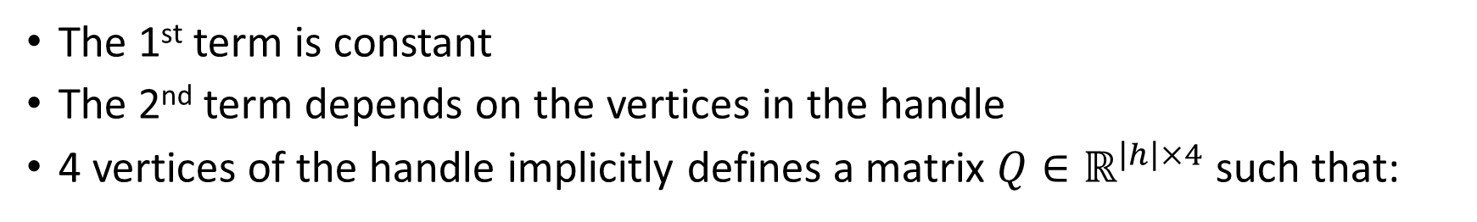
(Optional) Precomputed Basis
Inversing $L$ is heavy.
But the solution is separable:
The 1st term is constant
The 2nd term depends on the vertices in the handle
4 vertices of the handle implicitly defines a matrix $Q∈ℝ^{\left|h\right|×4}$ such that:

Slide 17
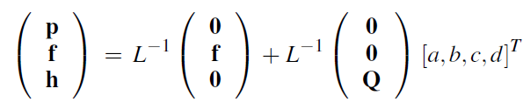
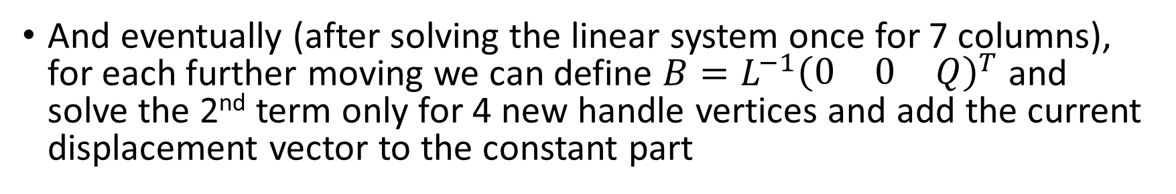
(Optional) Precomputed Basis – Cont.
Consequently, we can re-write the solution for the sparse linear system:
And eventually (after solving the linear system once for 7 columns), for each further moving we can define $B=L^{−1}{\left(\begin{matrix}0 & 0 & Q\end{matrix}\right)}^{T}$ and solve the 2nd term only for 4 new handle vertices and add the current displacement vector to the constant part

Slide 18


